Slide 1

Geometry
Unit 6, Lesson 6 Similarity in Transformations Volume 1, pg. 311

Slide 2


Benchmarks
MA.912.GR.2.8
Apply an appropriate transformation to map one figure onto another to justify that the two figures are similar.
MA.912.GR.2.3
Identify a sequence of transformations that will map a given figure onto itself or onto another congruent or similar figure.
volume 1, pg. 311

Slide 3
Integrated Mathematical Thinking and Reasoning Standards
MA.K12.MTR.1.1 Actively participate in effortful learning both individually and collectively.
MA.K12.MTR.2.1 Demonstrate understanding by representing problems in multiple ways.
MA.K12.MTR.4.1 Engage in discussions that reflect on the mathematical thinking of self and others.
MA.K12.MTR.5.1 Use patterns and structure to help understand and connect mathematical concepts.
MA.K12.MTR.6.1 Assess the reasonableness of solutions.
volume 1, pg. 311

Slide 4

Learning Targets
I can map one similar figure onto another and justify that the figures are similar.
I can describe a sequence of transformations that will map the preimage onto the image.
volume 1, pg. 311

Slide 5

Warm-Up
volume 1, pg. 311

Slide 6
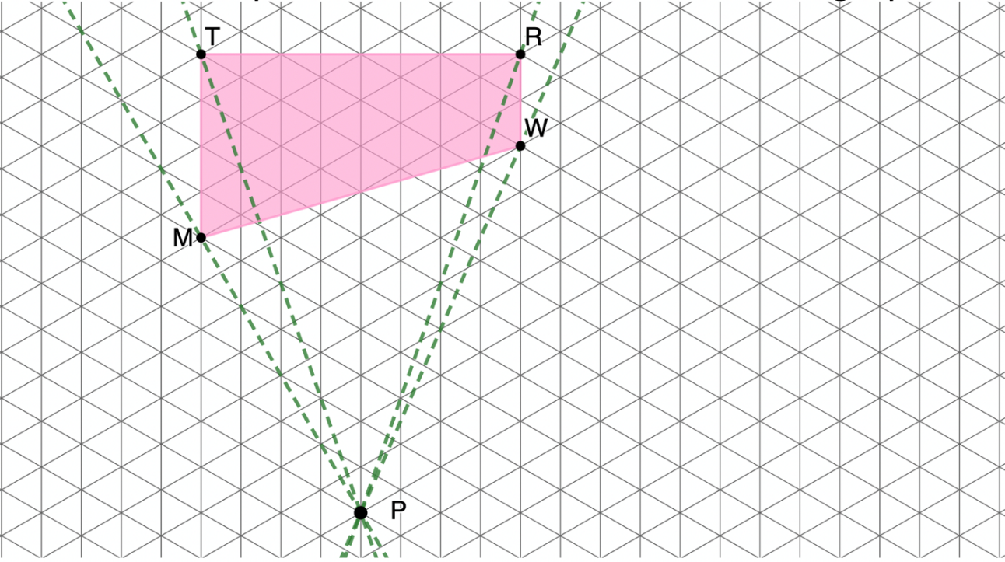
6.6.1 Warm-Up: Dilation on an Isometric Graph
$TRWM$ and point $P$ are drawn on an isometric graph.
volume 1, pg. 311

Slide 7
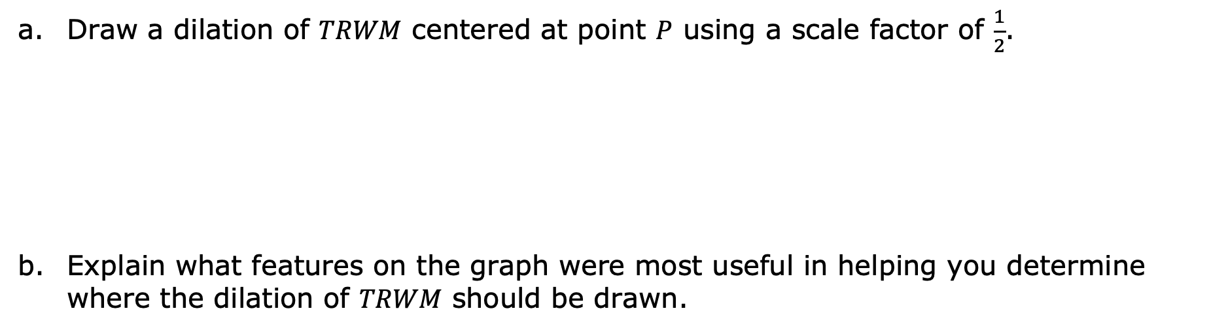
Draw a dilation of $TRWM$ centered at point $P$ using a scale factor of $\frac{1}{2}$.
Explain what features on the graph were most useful in helping you determine where the dilation of $TRWM$ should be drawn.
volume 1, pg. 311

Slide 8

Exploration
volume 1, pg. 312

Slide 9

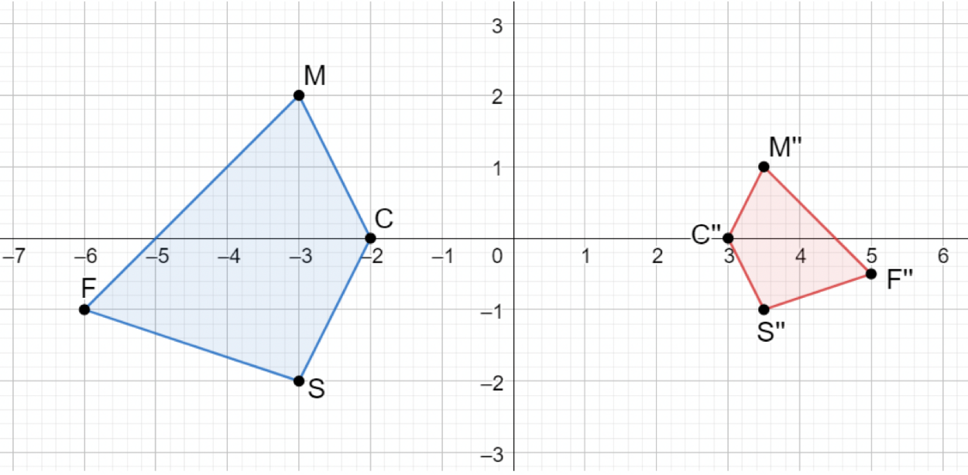
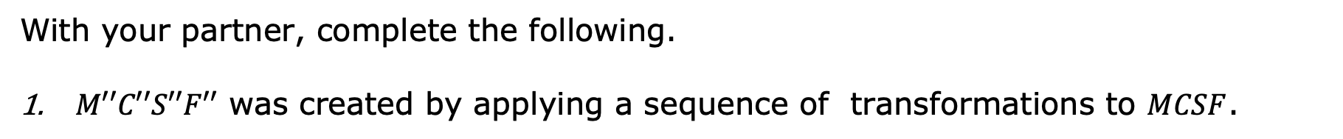
6.6.2 Exploration: Similarity
With your partner, complete the following.
$M′′C′′S′′F′′$ was created by applying a sequence of transformations to $MCSF$.
volume 1, pg. 312

Slide 10
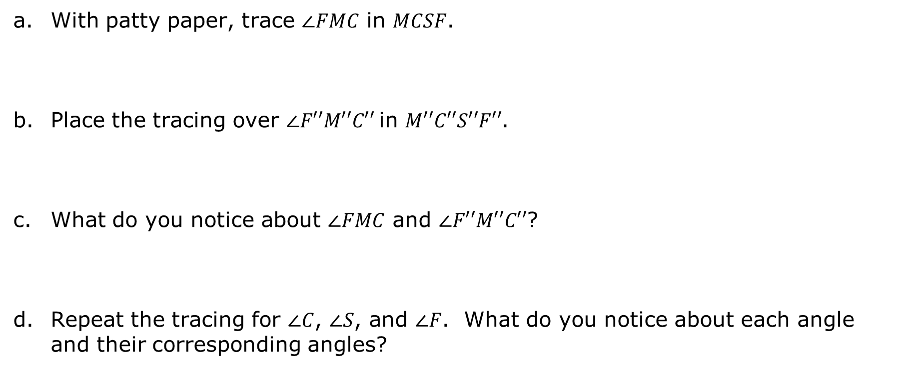
With patty paper, trace $∠FMC$ in $MCSF$.
Place the tracing over $∠F′′M′′C′′$in $M′′C′′S′′F′′$.
What do you notice about $∠FMC$ and $∠F′′M′′C′′$?
Repeat the tracing for $∠C$, $∠S$, and $∠F$. What do you notice about each angle and their corresponding angles?
volume 1, pg. 312

Slide 11


Complete the table.
Determine a sequence of transformations that can be used to map $MCSF$ to $M′′C′′S′′F′′$.
Angles | Comparison Between Angles
$∠FMC$ and $∠F′′M′′C′′$
$∠MCS$ and $∠M′′C′′S′′$
$∠CSF$ and $∠C′′S′′F′′$
$∠SFM$ and $∠S′′F′′M′′$
volume 1, pg. 312

Slide 12
Ask two classmates the transformations they determined. Record their transformations and write a summary of their reasoning. You are the only person who should write in the first two columns of the table. Have the person initial next to your summary stating your summary was correct. Remind your classmates to include any details on the center of rotation or dilation and any scale factor.
h. Work with your partner to verify your classmates’ transformations are correct.
Transformations | My Summary of Their Reason | Initials
volume 1, pg. 312

Slide 13
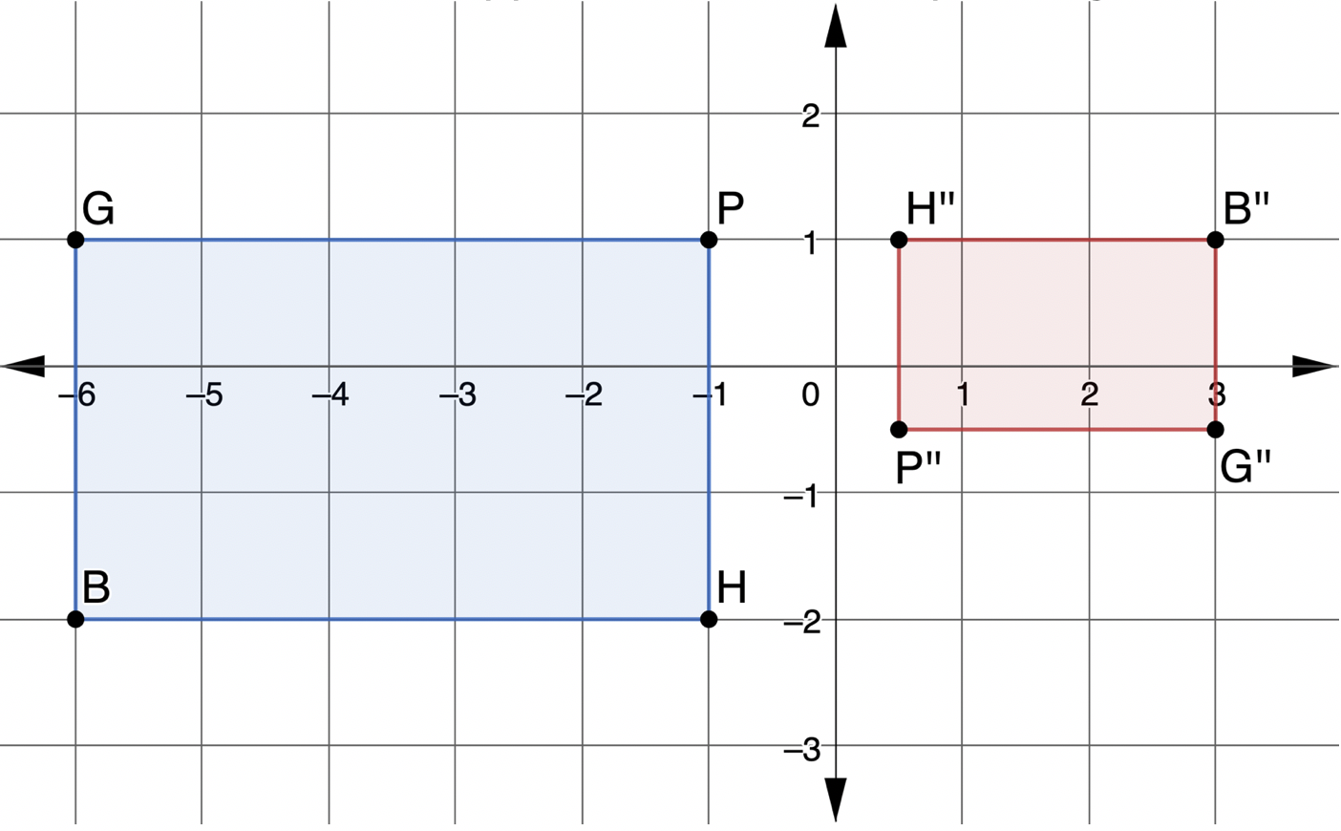
$H′′B′′G′′P′′$ was created using a sequence of transformations applied to $HBGP$, the preimage.
volume 1, pg. 313

Slide 14
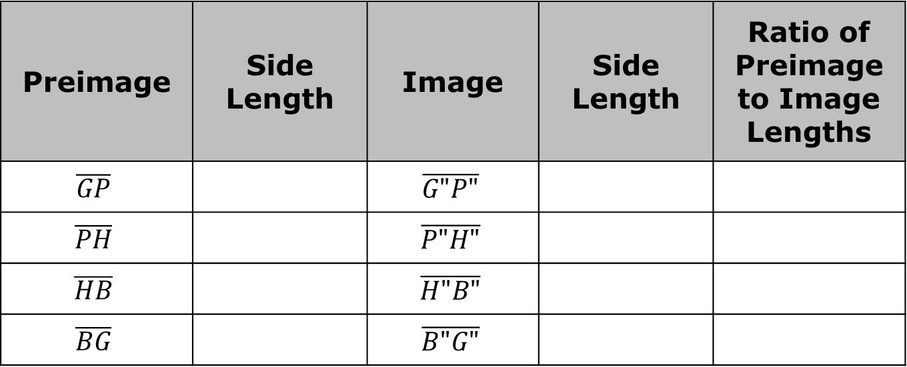
Complete the table.
Describe the relationship between the ratios of the preimage to the image.
Preimage | Side Length | Image | Side Length | Ratio of Preimage to Image Lengths
$$\overline{GP}$$ |  | $$\overline{G"P"}$$
$$\overline{PH}$$ |  | $$\overline{P"H"}$$
$$\overline{HB}$$ |  | $$\overline{H"B"}$$
$$\overline{BG}$$ |  | $$\overline{B"G"}$$
volume 1, pg. 313

Slide 15

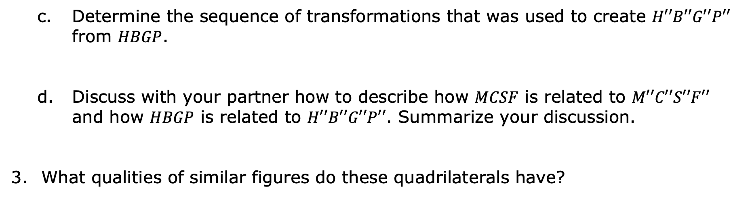
Determine the sequence of transformations that was used to create $H′′B′′G′′P′′$ from $HBGP$.
Discuss with your partner how to describe how $MCSF$ is related to $M′′C′′S′′F′′$ and how $HBGP$ is related to $H′′B′′G′′P′′$. Summarize your discussion.
What qualities of similar figures do these quadrilaterals have?
Similarity is having exactly the same shape but not necessarily the same size. Two figures are similar if and only if one figure can be obtained from the other by a dilation or a sequence of transformations that includes a dilation.
volume 1, pg. 313

Slide 16
Complete the statements using words from the bank.
Word Bank
congruent | dilation | proportional | similar
When a sequence of transformations includes a _____________, the resulting image of the sequence of transformations is ____________ to the preimage. All of the angles of the resulting image are ____________ to the corresponding angles of the preimage. The corresponding sides of the image to the preimage are _______________.
volume 1, pg. 314

Slide 17

Guided Practice
volume 1, pg. 314

Slide 18

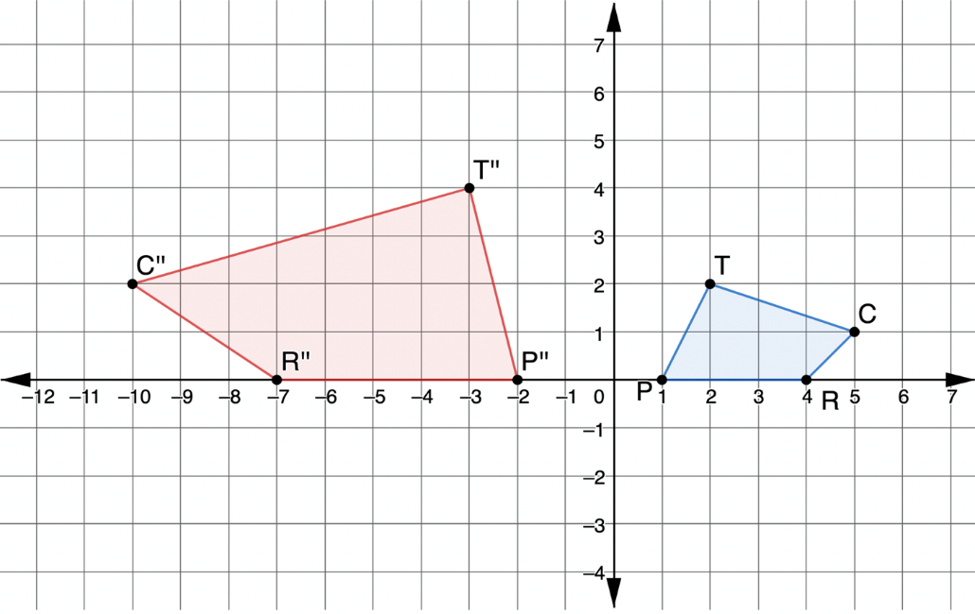
6.6.3 Guided Practice: Similarity
For each pair of figures, write the sequence of transformations that would show the figures are similar. If the figures are not similar, explain why.
1.
volume 1, pg. 314

Slide 19
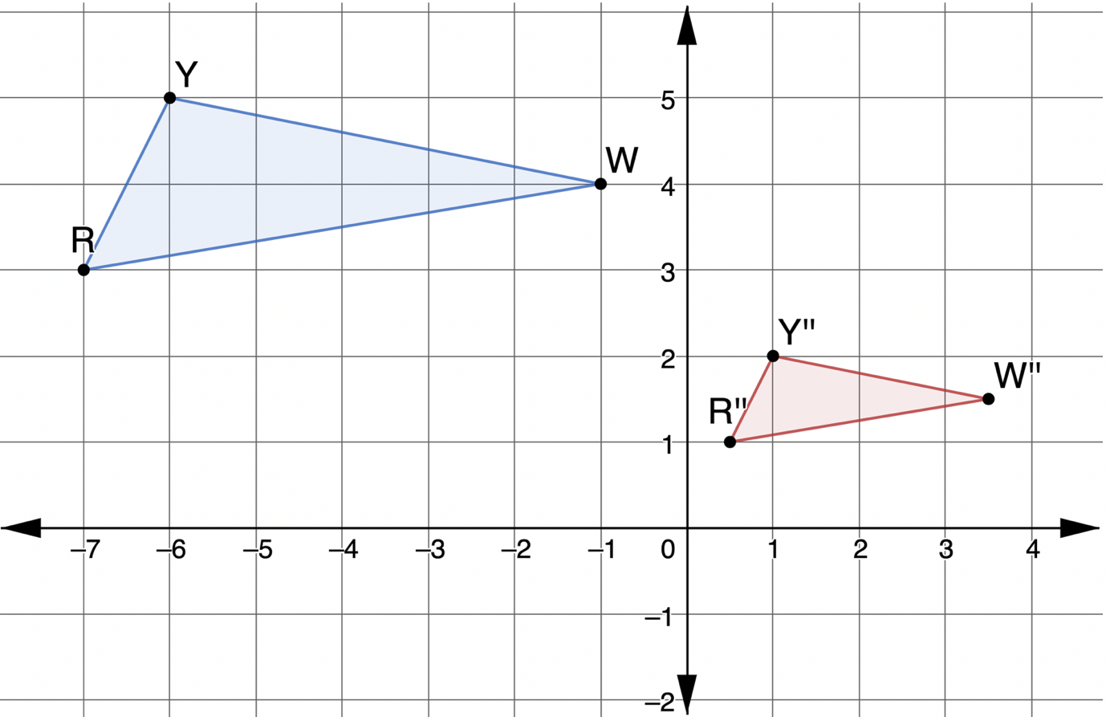
2.
volume 1, pg. 315

Slide 20
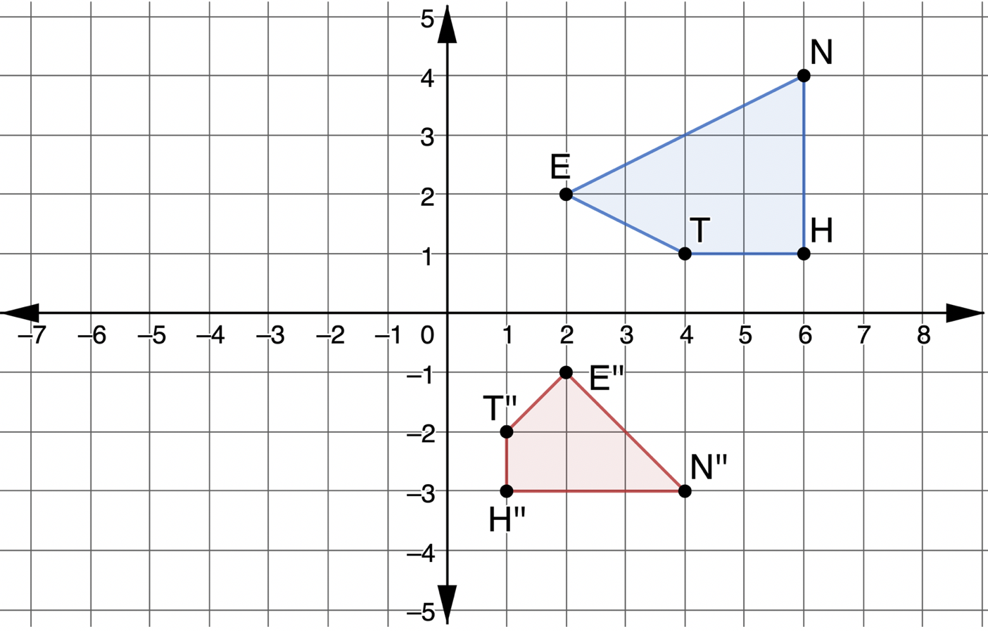
3.
volume 1, pg. 315

Slide 21

Your Turn
volume 1, pg. 316

Slide 22
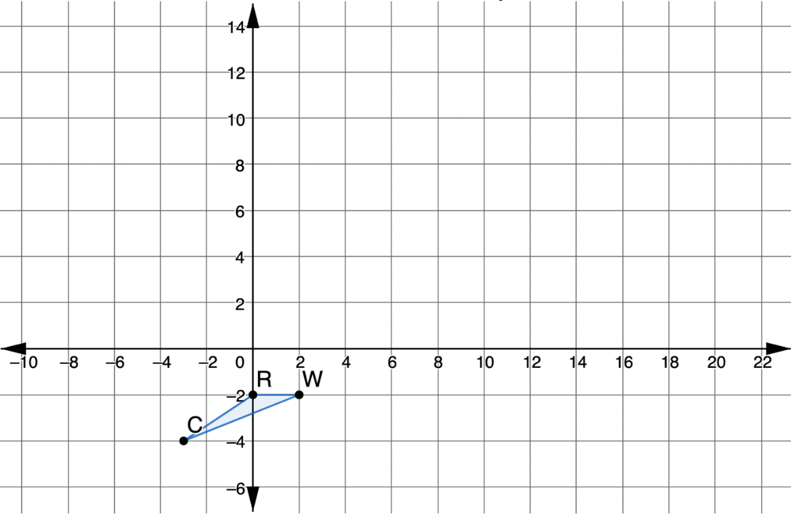
6.6.4 Your Turn!
$∆RWC$ is shown on the coordinate plane.
volume 1, pg. 316

Slide 23
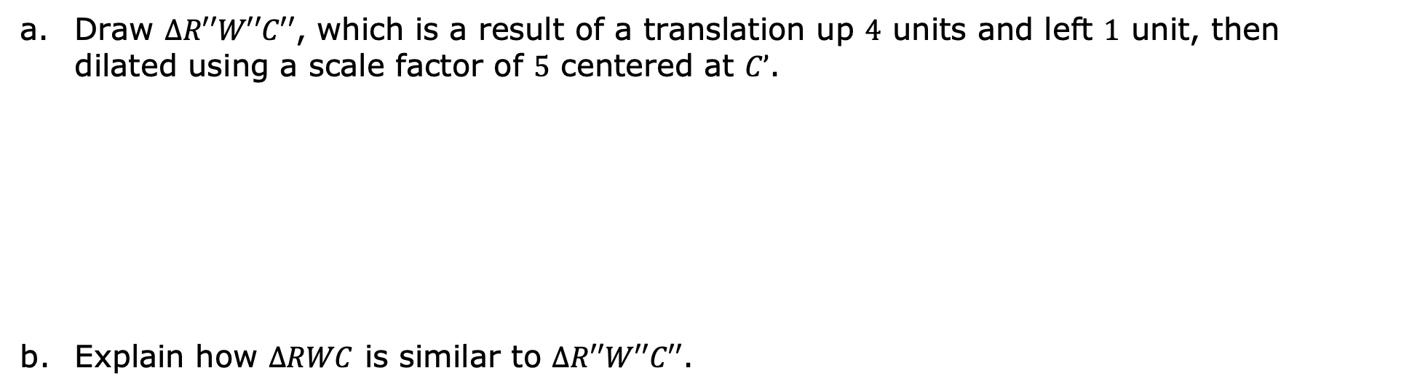
Draw $∆R′′W′′C′′$, which is a result of a translation up $4$ units and left $1$ unit, then dilated using a scale factor of $5$ centered at $C’$.
Explain how $∆RWC$ is similar to $∆R′′W′′C′′$.
volume 1, pg. 316

Slide 24
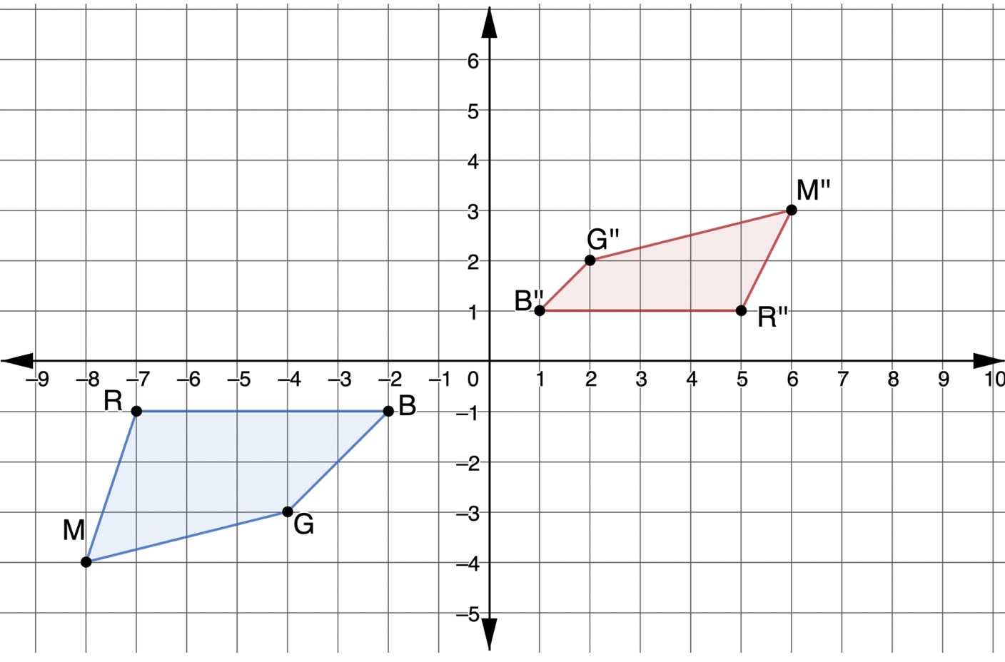
Carter and Isabella are asked to determine if the quadrilaterals are similar. Their responses are recorded in the table.
volume 1, pg. 316

Slide 25
Carter’s Response | Isabella’s Response
Yes, the quadrilaterals are similar because all the corresponding angles are congruent. | No, the quadrilaterals are not similar because the corresponding sides are not proportional.
Is Carter’s or Isabella’s response correct? Explain your decision.
volume 1, pg. 316

Slide 26

Wrap-Up
volume 1, pg. 317

Slide 27
6.6.5 Wrap-Up: Cool Down
Your friend is absent today and will need the notes from class. Write a quick note to help them understand how to determine if a sequence of transformations results in similar figures.
volume 1, pg. 317

